Slide 1
Minimum Spanning Trees
(some material adapted from slides by Peter Lee, Ananda Guna, Bettina Speckmann)

Slide 2
Problem: Laying Telephone Wire
Central office

Slide 3
Wiring: Naïve Approach
Central office
Expensive!

Slide 4
Wiring: Better Approach
Central office
Minimize the total length of wire connecting the customers

Slide 5
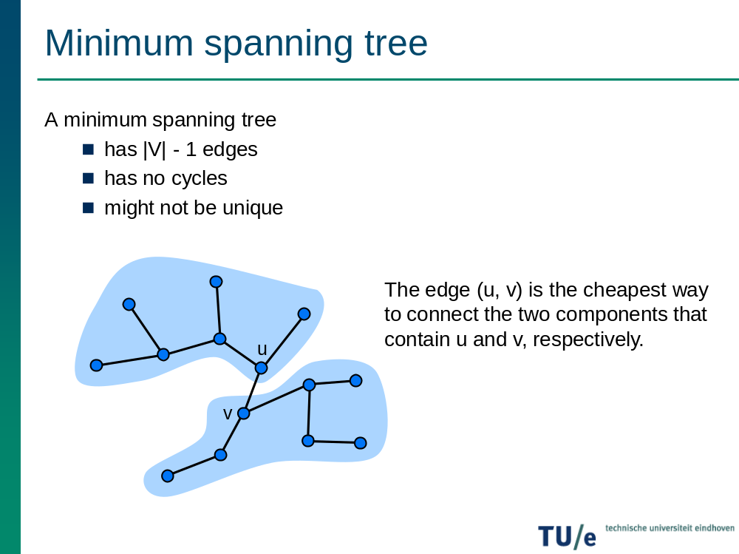

Slide 6
Minimum Spanning Tree (MST)
(see Weiss, Section 24.2.2)
A minimum spanning tree is a subgraph of an undirected weighted graph G, such that
it is a tree (i.e., it is acyclic)
it covers all the vertices V
  contains |V| - 1 edges
the total cost associated with tree edges is the minimum among all possible spanning trees
not necessarily unique

Slide 7
Applications of MST
Any time you want to visit all vertices in a graph at minimum cost (e.g., wire routing on printed circuit boards, sewer pipe layout, road planning…)

Slide 8
How Can We Generate a MST?
9
b
9
b
a
2
6
a
2
6
d
d
4
5
4
5
5
4
5
4
5
e
5
e
c
c

Slide 9
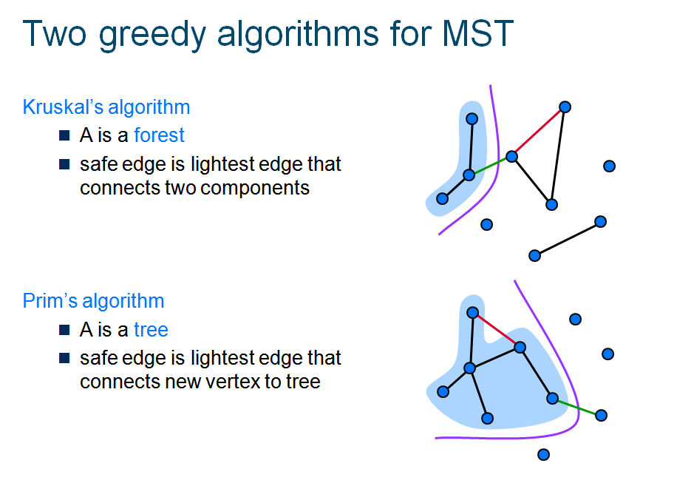

Slide 10
Prim’s Algorithm
Let V ={1,2,..,n} and U be the set of vertices that makes the MST and T be the MST
Initially : U = {1} and T = φ
while (U ≠ V)
let (u,v) be the lowest cost edge such that
u∈ U and v ∈ V-U
T = T ∪ {(u,v)}
U = U ∪ {v}

Slide 11
Prim’s Algorithm implementation
Initialization
a. Pick a vertex r to be the root
b. Set D(r) = 0, parent(r) = null
c. For all vertices v ∈ V, v ≠ r, set D(v) = ∞
d. Insert all vertices into priority queue P,
using distances as the keys
9
Vertex Parent
e -
b
a
2
6
e
a
b
c
d
d
4
5
0
∞
∞
∞
∞
5
4
5
e
c

Slide 12
Prim’s Algorithm
While P is not empty:
1. Select the next vertex u to add to the tree
u = P.deleteMin()
2. Update the weight of each vertex w adjacent to u which is not in the tree (i.e., w ∈ P)
If weight(u,w) < D(w),
a. parent(w) = u
b. D(w) = weight(u,w)
c. Update the priority queue to reflect
new distance for w

Slide 13
Prim’s algorithm
9
Vertex Parent
e -
b e
c e
d e
b
a
2
6
d
b
c
a
d
4
5
4
5
5
∞
5
4
5
e
c
The MST initially consists of the vertex e, and we update
the distances and parent for its adjacent vertices

Slide 14
Prim’s algorithm
9
Vertex Parent
e -
b e
c d
d e
a d
b
a
2
6
a
c
b
d
4
5
2
4
5
5
4
5
e
c

Slide 15
Prim’s algorithm
9
Vertex Parent
e -
b e
c d
d e
a d
b
a
2
6
c
b
d
4
5
4
5
5
4
5
e
c

Slide 16
Prim’s algorithm
9
Vertex Parent
e -
b e
c d
d e
a d
b
a
2
6
b
d
4
5
5
5
4
5
e
c

Slide 17
Prim’s algorithm
9
Vertex Parent
e -
b e
c d
d e
a d
b
a
2
6
d
4
5
5
4
5
e
c
The final minimum spanning tree

Slide 18
Prim’s Algorithm Invariant
At each step, we add the edge (u,v) s.t. the weight of (u,v) is minimum among all edges where u is in the tree and v is not in the tree
Each step maintains a minimum spanning tree of the vertices that have been included thus far
When all vertices have been included, we have a MST for the graph!

Slide 19
Another Approach – Kruskal’s
Create a forest of trees from the vertices
Repeatedly merge trees by adding “safe edges” until only one tree remains
A “safe edge” is an edge of minimum weight which does not create a cycle
9
b
a
2
6
d
forest: {a}, {b}, {c}, {d}, {e}
4
5
5
4
5
e
c

Slide 20
Kruskal’s algorithm
Initialization
a. Create a set for each vertex v ∈ V
b. Initialize the set of “safe edges” A comprising the MST to the empty set
c. Sort edges by increasing weight
9
b
a
2
6
{a}, {b}, {c}, {d}, {e}
A = ∅
E = {(a,d), (c,d), (d,e), (a,c),
(b,e), (c,e), (b,d), (a,b)}
d
4
5
5
4
5
e
c

Slide 21
Kruskal’s algorithm
For each edge (u,v) ∈ E in increasing order while more than one set remains:
If u and v, belong to different sets
a. A = A ∪ {(u,v)}
b. merge the sets containing u and v
Return A
Use Union-Find algorithm to efficiently determine if u and v belong to different sets

Slide 22
Kruskal’s algorithm
9
b
a
2
6
d
E = {(a,d), (c,d), (d,e), (a,c),
(b,e), (c,e), (b,d), (a,b)}
4
5
5
4
5
e
c
Forest
{a}, {b}, {c}, {d}, {e}
{a,d}, {b}, {c}, {e}
{a,d,c}, {b}, {e}
{a,d,c,e}, {b}
{a,d,c,e,b}
A
∅
{(a,d)}
{(a,d), (c,d)}
{(a,d), (c,d), (d,e)}
{(a,d), (c,d), (d,e), (b,e)}

Slide 23
Kruskal’s Algorithm Invariant
After each iteration, every tree in the forest is a MST of the vertices it connects
Algorithm terminates when all vertices are connected into one tree

Slide 24
Greedy Approach
Like Dijkstra’s algorithm, both Prim’s and Kruskal’s algorithms are greedy algorithms
The greedy approach works for the MST problem; however, it does not work for many other problems!

Slide 25
Kruskal’s Algorithm for Finding MST
Step 1: Sort all edges into nondecreasing order.
Step 2: Add the next smallest weight edge to the forest if it will not cause a cycle.
Step 3: Stop if n-1 edges. Otherwise, go to Step2.

Slide 26
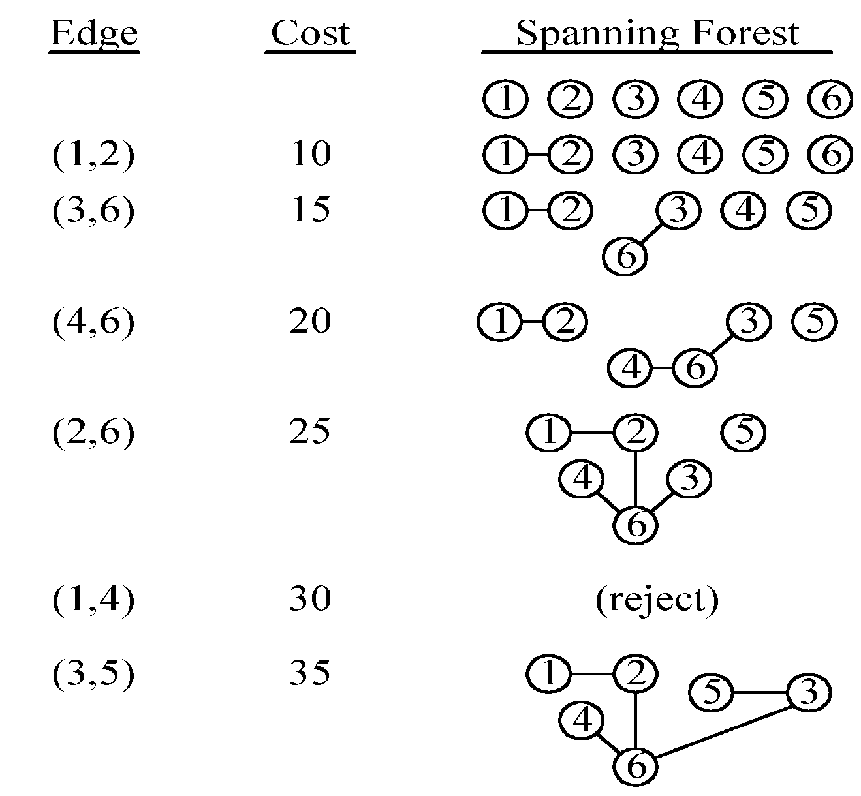
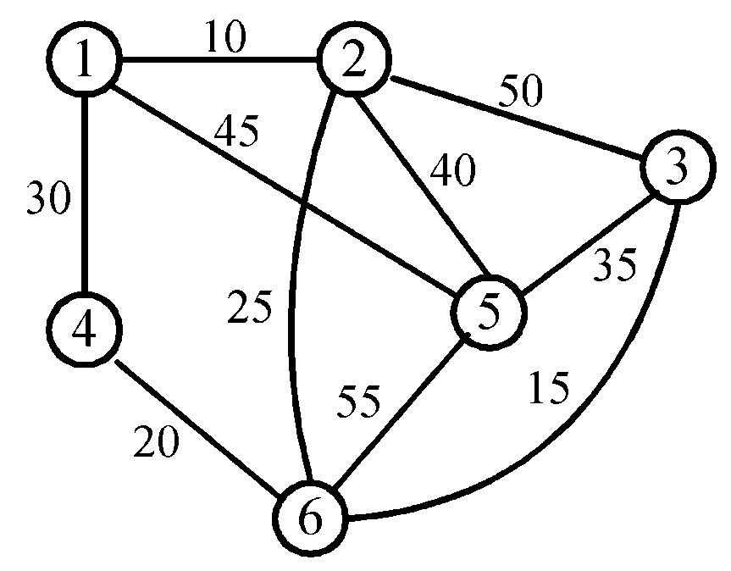
An example of Kruskal’s algorithm
2 -<number>

